Slide 1

Classification (Ensemble Methods) Part 1: Bagging
by:
Eng. Alaa Al Nissany

Slide 2
Machine Learning
Supervised Learning
Unsupervised Learning
Reinforcement Learning
Classification
Clustering
Q-Learning
Regression
Anomaly Detection
DQN
Ranking
Dimensionality reduction

Slide 3
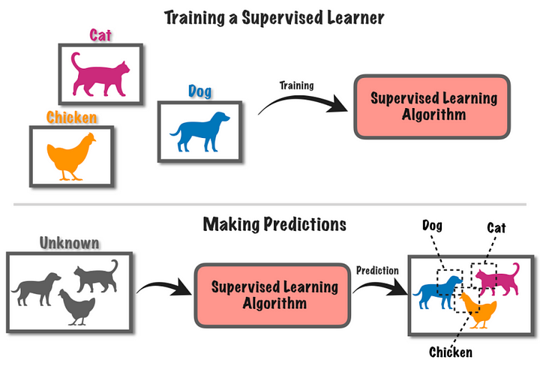
Supervised Learning

Slide 4

Ensemble Learning
Data

Slide 5
Ensemble Learning
Data

Slide 6
Ensemble Learning
Data

Slide 7


Ensemble Learning
Predictions
Final Prediction
Voting
Data
OR

Slide 8
Voting
Hard Voting | Soft Voting
Predictions
Predictions
30% cat | 70% Dog
Dog
Final Prediction
Final Prediction
3 Dog | 1 Cat
74.25 Dog | 25.75% Cat
10% cat | 90% Dog
Dog
60% cat | 40% Dog
Cat
OR
OR
3% cat | 97% Dog
Dog

Slide 9
Ensemble Learning
Bagging
Boosting
Stacking

Slide 10
Bagging

Slide 11
Bootstrap the Data
Animal | Color | Size | Cuteness
Dog | Brown | Small | Medium
Cat | Brown | Small | Medium
Dog | Brown | Small | High
Cat | Gold | Medium | High
Cat | Black | Medium | High
Dog | Gold | Small | Medium
Cat | Brown | Medium | Low
Dog | Gold | Large | High
Cat | Brown | Medium | Medium
Dog | Black | Large | High
Cat | Gold | Large | Medium
Cat | Brown | Small | High

Slide 12
Bootstrap the Data
Animal | Color | Size | Cuteness
Dog | Brown | Small | Medium
Cat | Brown | Small | Medium
Dog | Brown | Small | High
Cat | Gold | Medium | High
Cat | Black | Medium | High
Dog | Gold | Small | Medium
Cat | Brown | Medium | Low
Dog | Gold | Large | High
Cat | Brown | Medium | Medium
Dog | Black | Large | High
Cat | Gold | Large | Medium
Cat | Brown | Small | High
Animal | Color | Size | Cuteness
Cat | Gold | Large | Medium
Dog | Brown | Small | Medium
Dog | Brown | Small | High
Cat | Gold | Medium | High
Cat | Black | Medium | High
Dog | Gold | Large | High
Dog | Brown | Small | Medium
Cat | Black | Medium | High
Make Redundant Records (Samples with replacement)

Slide 13
Bootstrap the Data
Animal | Color | Size | Cuteness
Cat | Gold | Large | Medium
Dog | Brown | Small | Medium
Dog | Brown | Small | High
Cat | Gold | Medium | High
Cat | Black | Medium | High
Dog | Gold | Large | High
Dog | Brown | Small | Medium
Cat | Black | Medium | High

Slide 14
Bootstrap the Data
Animal | Color | Size | Cuteness
Cat | Gold | Large | Medium
Dog | Brown | Small | Medium
Cat | Brown | Medium | Low
Cat | Gold | Medium | High
Cat | Black | Medium | High
Dog | Gold | Large | High
Dog | Brown | Small | Medium
Cat | Brown | Medium | Low

Slide 15
Bootstrap the Data

Slide 16
Aggregating the predictions
Predictions
Final Prediction
Voting
Data
OR

Slide 17
Pasting

Slide 18
Bootstrap
Sample
the Data
Animal | Color | Size | Cuteness
Dog | Brown | Small | Medium
Cat | Brown | Small | Medium
Dog | Brown | Small | High
Cat | Gold | Medium | High
Cat | Black | Medium | High
Dog | Gold | Small | Medium
Cat | Brown | Medium | Low
Dog | Gold | Large | High
Cat | Brown | Medium | Medium
Dog | Black | Large | High
Cat | Gold | Large | Medium
Cat | Brown | Small | High

Slide 19
Sample the Data
Animal | Color | Size | Cuteness
Dog | Brown | Small | Medium
Cat | Brown | Small | Medium
Dog | Brown | Small | High
Cat | Gold | Medium | High
Cat | Black | Medium | High
Dog | Gold | Small | Medium
Cat | Brown | Medium | Low
Dog | Gold | Large | High
Cat | Brown | Medium | Medium
Dog | Black | Large | High
Cat | Gold | Large | Medium
Cat | Brown | Small | High
Animal | Color | Size | Cuteness
Cat | Gold | Large | Medium
Dog | Brown | Small | Medium
Dog | Brown | Small | High
Cat | Gold | Medium | High
Cat | Black | Medium | High
Dog | Gold | Large | High
Dog | Brown | Small | Medium
Cat | Black | Medium | High
Samples without replacement

Slide 20
Out Of Bag
63% of the training instances are sampled on average for each predictor
37% of the training instances that are not sampled
OOB

Slide 21
Random Patches vs Random Subspaces
Random Patches | Random Subspaces
We sample both Training instances and features | We keep all Training instances and sample features
Sampling Features trade more bias for lower variance

Slide 22
Some Famous Bagging algorithms
Random Forest | EXTRA Trees
Optimized Bagging classifier on Decision Tree | Random Forest with splitting the subset of the data in every node by selecting a random thresholds for each feature in each node

Slide 23
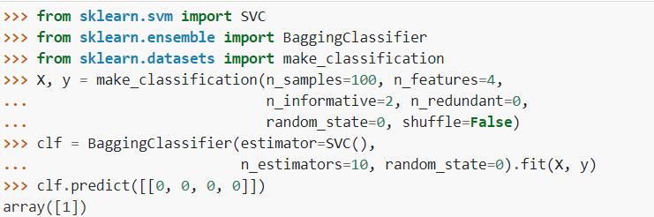
Bagging Classifier Using SkLearn
https://scikit-learn.org/stable/modules/generated/sklearn.ensemble.BaggingClassifier.html

Slide 24
Important parameters
estimator | The base classifier
n_estimators | The Number of base estimators in the ensemble.
max_samples | The number of samples to draw from training set to train each base estimator
max_featurs | The number of features to draw from training set to train each base estimator.
bootstrap | True: samples are drawn with replacement False: sampling are drawn without replacement
oob_score | to use out-of-bag samples to estimate the generalization error
https://scikit-learn.org/stable/modules/generated/sklearn.ensemble.BaggingClassifier.html

Slide 25
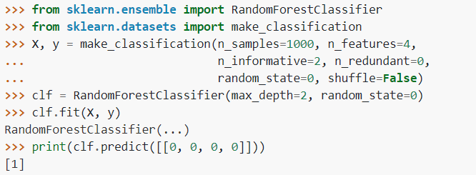
Random Forest Classifier Using SkLearn
https://scikit-learn.org/stable/modules/generated/sklearn.ensemble.RandomForestClassifier.html

Slide 26
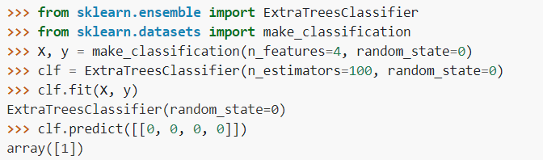
Extra Trees Classifier Using SkLearn
https://scikit-learn.org/stable/modules/generated/sklearn.ensemble.ExtraTreesClassifier.html

Slide 27
Thank you for listening

Slide 28
Any Questions
?

